Slide 1
E-retail factors for customer activation and retention

Slide 2

Introduction
Customer Satisfaction – A key stimulant to purchase, repurchase intentions and customer loyalty.
Major factors that contributed to the success of an e-commerce store - Service Quality, System Quality, Information Quality, Trust and Net Benefit.

Slide 3

Objective
Data Analysis of factors for customer activation and retention for Indian E-commerce stores

Slide 4
Data Info
1
Let’s start with Data Pre-processing

Slide 5
269 Entries
71 Columns
70 Object Datatype & 1 Integer Datatype
All are non-null values

Slide 6
Data Visualization – Univariate Analysis
2
Let’s start with our visualization on the dataset using Univariate Analysis Techniques

Slide 7
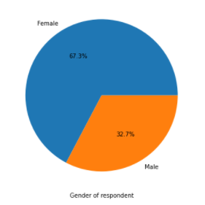
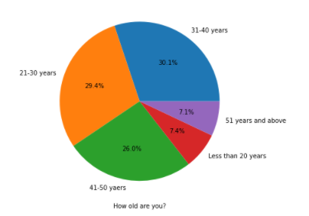
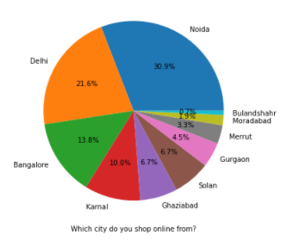
Analysis of Personal Info
The number of women who were a part of this survey is more than double that of men.
Online customers are least in the age-group below 20 years and above 51 years.
Majority of the population are from Noida followed by Delhi and then Bangalore

Slide 8
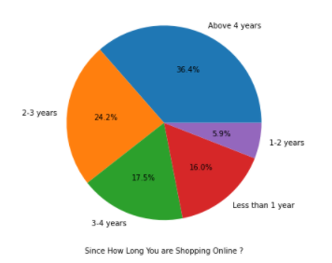
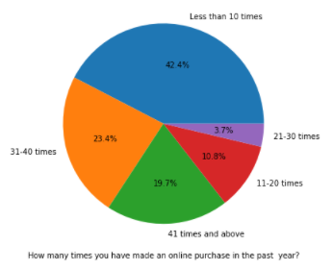
Analysis of Shopping Experience
Majority of the population have shopping experience of more than 4 years.
Majority of the population ordered online less than 10 times in the past year which only a few ordered 21 – 30 times.

Slide 9
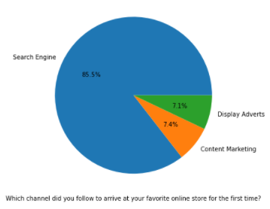
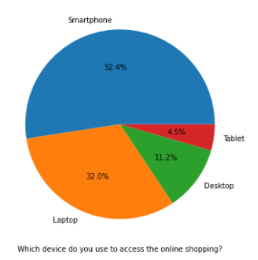
Analysis of Browser Experience
Around 85% of the population use the search engine to reach the online store
Around 7% reach the online store through 'Content Marketing' and 'Display Adverts'.
The reach of the advertisement is close to 15%.
52% of the population prefer to access online store using their smartphones.

Slide 10
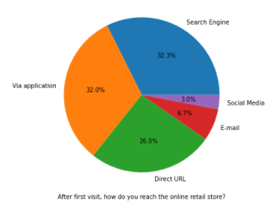
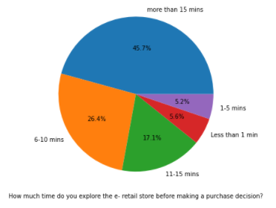
Analysis of Browser Experience
After first visit 32% of the population prefer to access the store using the application
26% access the store directly through URL.
Majority of the population spend more than 15 minutes before making a purchase decision,
Less than 11 percent of population take less than 5 minutes to finalize the purchase.

Slide 11
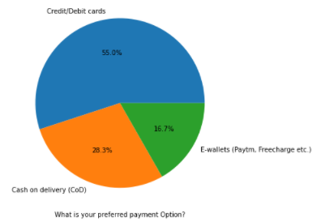
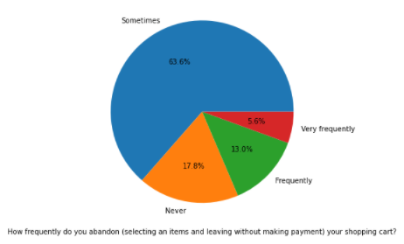
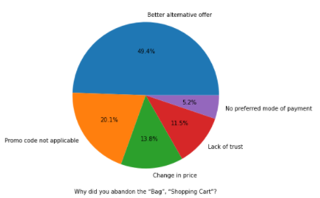
Analysis of Payment Experience
Majority of the user prefer payment through Credit Cards or Debit Cards.
16.7% of population prefer to use E-wallets for payments.
63.6% of population sometime abandon the cart without payment.
Around 50% of population abandon the bag because they get better offer in other stores.
Around 20% of population abandon the bag because the promo code do not apply.
11.5 % abandon the bag due to lack of trust.
Around 5% of population abandon because they don't have options for their preferred payment mode.

Slide 12
Good Remarks vs Bad Remarks
Majority of the user voted amazon and Flipkart as 'Easy to use website or application'
Majority of the user voted amazon and Flipkart as 'Visually appealing web-page layout'
Majority of the user voted that both amazon and Flipkart offer wide variety of product on offer as compared to others.
Majority of the user voted Amazon and Flipkart have complete, relevant description and information of products.
In most of categories Amazon and Flipkart have given good remarks as compared to other online stores.
During promotion or sale more than 46% of the user experience longer time to get logged into Amazon.
During promotion or sale more than 36% of the user experience longer time in displaying graphics and photos in Amazon.
During promotion or sale majority of user reported late declaration of price in Myntra followed by Paytm
During promotion or sale majority of the user experienced longer page loading time in Myntra and Paytm.
During promotion or sale majority of the user have limited mode of payment in Snapdeal followed by Amazon.
Majority of the user experienced longer delivery period in Paytm followed by Snapdeal.
Majority of the user experienced frequent disruption when moving from one page to another in Amazon, Myntra and Snapdeal.

Slide 13
Data Visualization – Bivariate Analysis
3

Slide 14
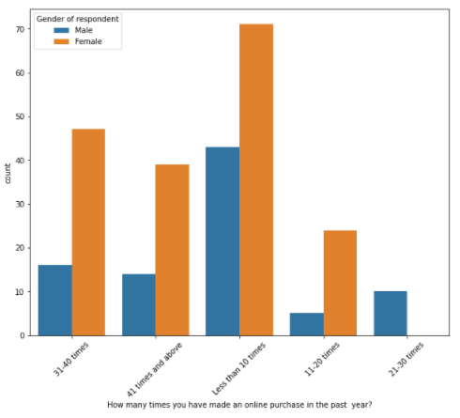
Females have more tendency of shopping frequently

Slide 15
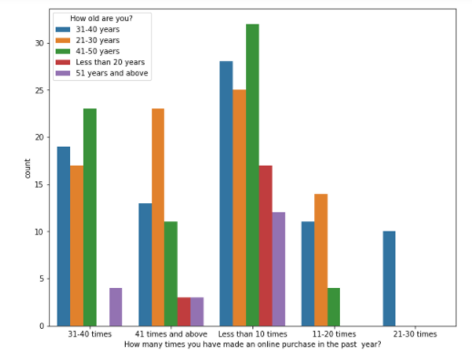
The age group ‘Below 20 years’ and ’above 51 years’ do not shop as frequently as other age groups.

Slide 16
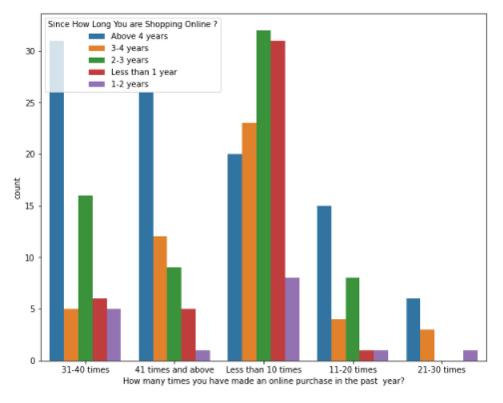
Usually those who have been shopping for more than 4 years order online more frequently.

Slide 17
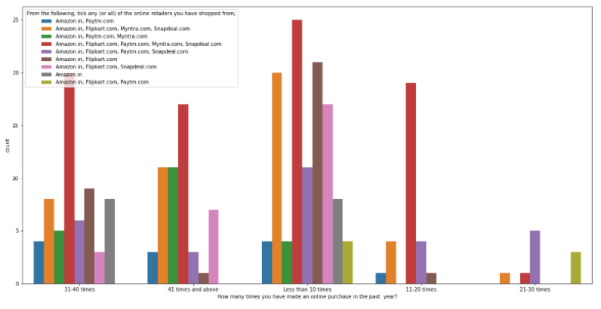
Most of the online purchase was done through Amazon followed by Flipkart

Slide 18
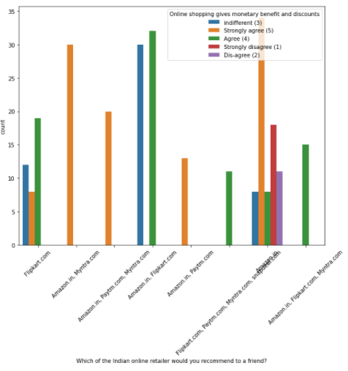
The users who are recommending Amazon, Myntra and Paytm strongly agree that online shopping gives monetary benefits and discounts.

Slide 19
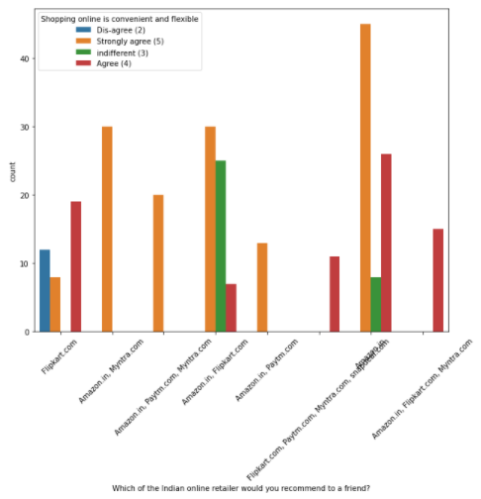
Some of the Flipkart user feel that shopping online is neither convenient nor flexible

Slide 20
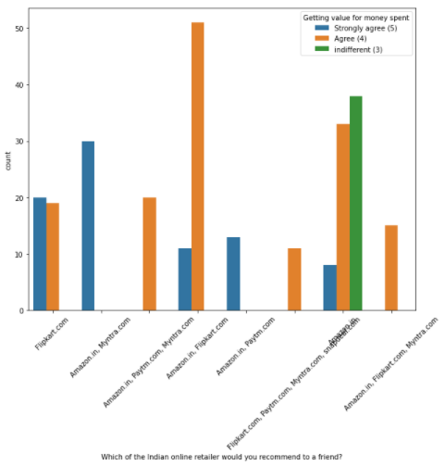
Most of the user feel that in almost all the online store they get value for money spent

Slide 21
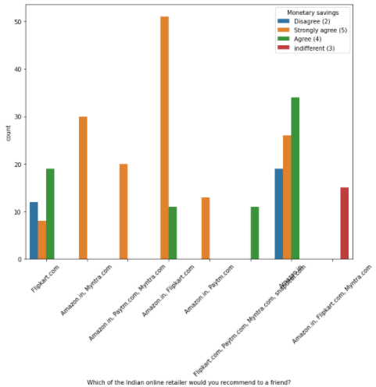
Most of the user saved money though online purchase

Slide 22
Conclusion

Slide 23
The following factors impact the purchase, the intention to repurchase and customer loyalty
User friendly interface
Longer Response Time
Non availability of Graphics and Images
Limited Payment Modes
Slow Delivery
Smooth Navigation
Visually Appealing Layout
Product Variety
Complete Descriptions

